Slide 1














DWH PROJECT
Flughafen Air Travel Analysis
MUHAMMAD GHULAM ABBAS 29417
ADNAN ALI 29401

Slide 2
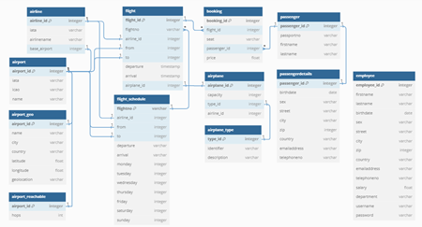
1.Database
We utilized the Flugahfendb small dataset (https://github.com/stefanproell/flughafendb), a free sample provided by MySQL for demonstrating the warehousing capabilities of MySQL and Oracle products. Although a larger dataset is available, we opted for the smaller dataset, which we minimally modified and primarily retained in its original form. We extracted the data from the MySQL dump into CSV files for our use, focusing on a limited subset of the data.

Slide 3
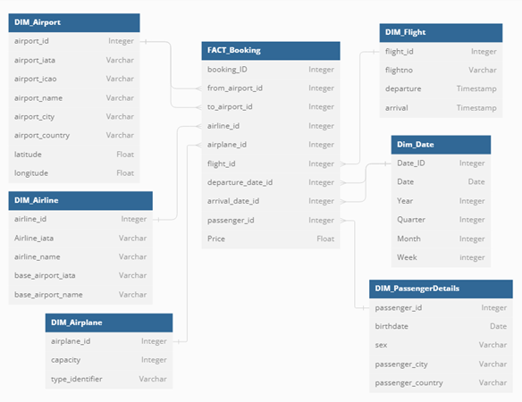
2.Datamart
STAR SCHEMA
Implement a data mart providing analysis of flight bookings
Our company specializes in flight management. Our transactional database stores comprehensive information about airports, airlines, passengers, flights, and bookings. Notably, a passenger can make multiple bookings on the same flight.
The database also contains additional information, such as details about employees, weather, and flight schedules, which are not pertinent to our analysis.

Slide 4
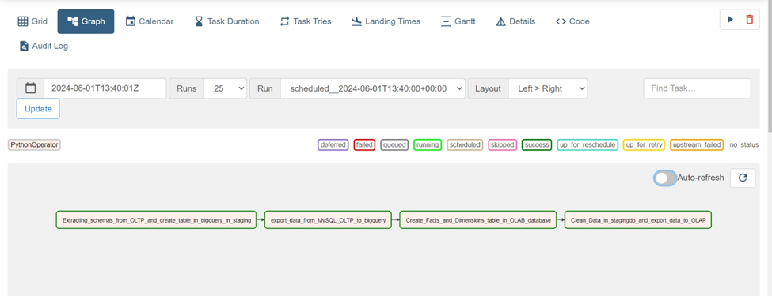
3.Datawarehouse pipline
Python orchestrates data manipulation, transformation, and automation, ensuring code reusability and maintainability.
Libraries like Pandas and Google Cloud Client enhance Python's capabilities for data manipulation and integration with GCP services.
BigQuery serves as the core data repository and processing engine within the GCP environment, enabling storage and querying of vast volumes of structured data securely.
Apache Airflow acts as the orchestrator, providing workflow automation and monitoring functionalities through Directed Acyclic Graphs (DAGs), facilitating efficient execution of tasks.
A "Stored Procedure-Like Approach" encapsulates ETL logic into reusable Python functions, promoting modularity and maintainability.
In summary, the integrated use of Python, GCP, BigQuery, and Apache Airflow results in a robust and scalable data engineering solution. This integration streamlines ETL processes, allowing organizations to derive valuable insights from their data assets for informed decision-making and business growth.

Slide 5
4.Coding files
The code's purpose is to automate the synchronization of data between a MySQL database and Google BigQuery, ensuring that the data in BigQuery remains up-to-date with the latest information from MySQL.By using this code we get new data
https://github.com/MuhammadGhulamAbbas/Semester-Project-Datawarehousing/blob/main/Pipeline%20Python%20Script%20(Conversion%20Functions)%20(PYT)/export_data_to_bigquery.py
The scope of the code is to connect to a MySQL database, retrieve schema information for its tables, convert the schema to a BigQuery-compatible format, and generate alter statements for primary keys if necessary.
https://github.com/MuhammadGhulamAbbas/Semester-Project-Datawarehousing/blob/main/Pipeline%20Python%20Script%20(Conversion%20Functions)%20(PYT)/ddl_sql2.py
This code snippet focuses on the create_table_in_bigquery function, which is responsible for creating tables and primary keys in BigQuery based on DDL statements retrieved from another function.
https://github.com/MuhammadGhulamAbbas/Semester-Project-Datawarehousing/blob/main/Pipeline%20Python%20Script%20(Conversion%20Functions)%20(PYT)/create_bigquery_table.py
This code provides a script for creating and defining the schema for an airline reservation system data warehouse in BigQuery. It emphasizes data integrity by including primary and foreign key constraints, although they are not strictly enforced by default.
https://github.com/MuhammadGhulamAbbas/Semester-Project-Datawarehousing/blob/main/Pipeline%20Python%20Script%20(Conversion%20Functions)%20(PYT)/Facts_and_Dimensions.py

Slide 6
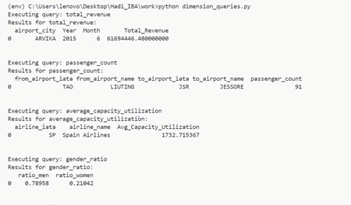
5.Coding files
this script serves as a tool to analyze data in your BigQuery OLAP data warehouse by executing predefined SQL queries and presenting the results in a clear and structured format (using DataFrames).
https://github.com/MuhammadGhulamAbbas/Semester-Project-Datawarehousing/tree/main/Pipeline%20Python%20Script%20(Dimensional%20Query%20Functions
this script automates the process of transferring data from an OLTP dataset to an OLAP dataset in Google BigQuery, ensuring data cleanliness and integrity throughout the process by using the concept of stored procedure
https://github.com/MuhammadGhulamAbbas/Semester-Project-Datawarehousing/blob/main/Pipeline%20Python%20Script%20(Conversion%20Functions)%20(PYT)/ddl_sql2.py
this script creates a snapshot for the fact table by joining all dimensions and fact together
https://github.com/MuhammadGhulamAbbas/Semester-Project-Datawarehousing/blob/main/Pipeline%20Python%20Script%20(Generation%20of%20Fact%20Table%20Snapshot)/Pipeline%20Python%20Script%20(Generation%20of%20Fact%20Table%20Snapshot).py
h

Slide 7
MAIN DAG AIRFLOW FILE
This Airflow DAG automates the process of moving data from an OLTP system to an OLAP system using Google Cloud services. Here's how it works:
Setup Default Arguments:
The DAG is initialized with default arguments like owner, start date, retries, and retry delay.
Task Definitions:
Several PythonOperator tasks are defined:
create_table_in_bigquery: Extracts schemas from the OLTP system and creates tables in BigQuery's staging dataset.
export_data_to_bigquery: Transfers data from a MySQL OLTP database to BigQuery.
Facts_and_Dimensions: Creates facts and dimensions tables in the OLAP database.
export_data_from_OLTP_to_OLAP: Cleans data in the staging database and exports it to the OLAP dataset.
DAG Structure:
Tasks are organized with dependencies using the >> operator, ensuring they run sequentially. For instance, create_table_in_bigquery must finish before export_data_to_bigquery starts.
Schedule Interval:
The DAG is scheduled to run every 10 minutes ("*/10 * * * *").
Catchup and Max Active Runs:
Parameters like catchup and max_active_runs control Airflow's handling of past runs and the maximum number of concurrent DAG runs.
Tags:
Tags are added to categorize the DAG for organizational purposes.
When triggered, Airflow schedules and executes tasks based on dependencies and schedule intervals. Each task invokes a Python function to perform its data processing task. Airflow logs the status and results of each task, providing visibility into the pipeline's progress and any issues encountered.
This setup ensures a robust and automated data pipeline, facilitating efficient data movement from OLTP to OLAP systems.
https://github.com/MuhammadGhulamAbbas/Semester-Project-Datawarehousing/blob/main/Pipeline%20Python%20Script%20(Conversion%20Functions)%20(PYT)/main_dags.py

Slide 8

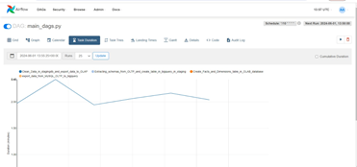
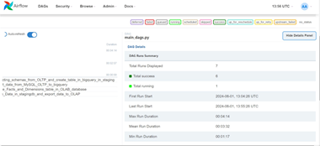
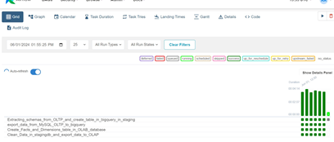

Slide 9
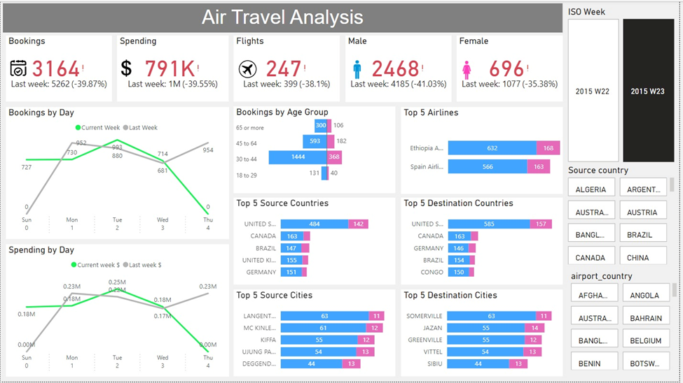
Powerbi file Before Change

Slide 10
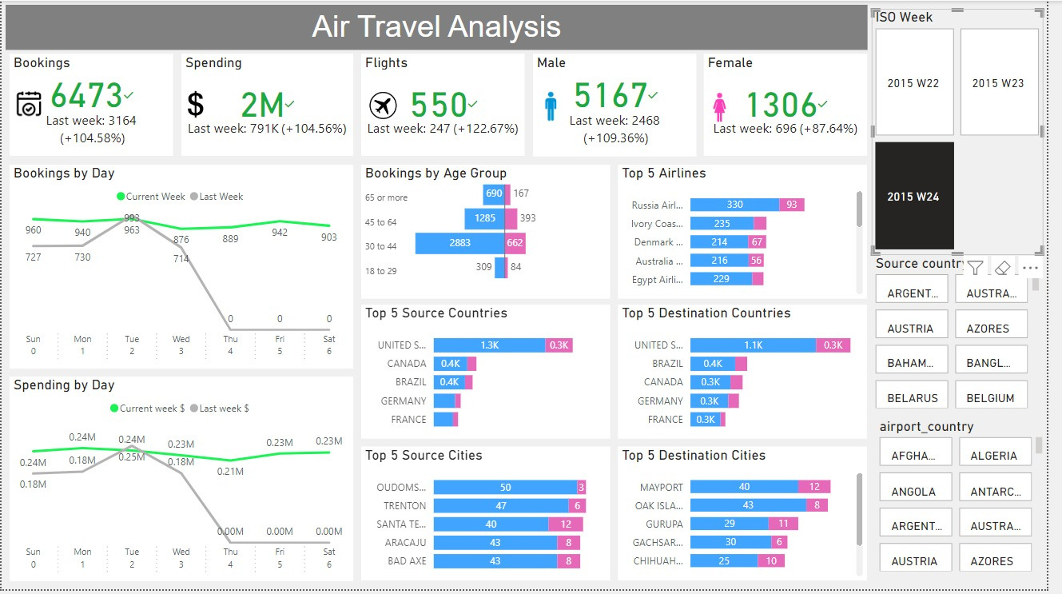
Powerbi file After Change

Slide 11
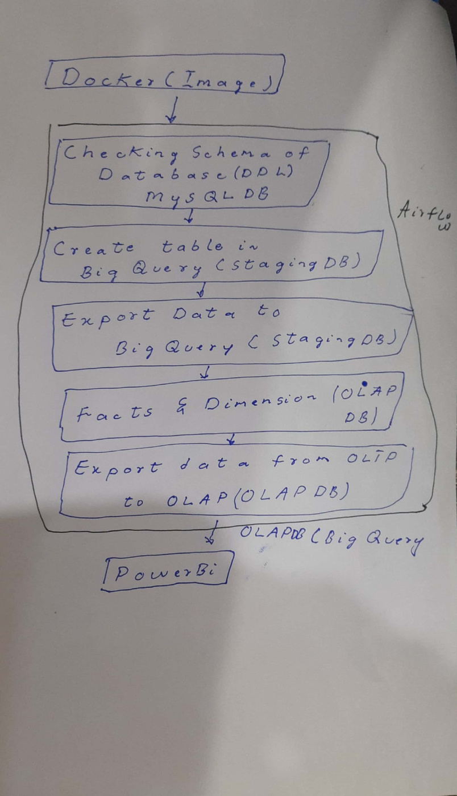
DIAGRAM FOR DATAWAREHOUSE

Slide 12
Thank you very much!

